Slide 1

Database Theory and Applications for Biomedical Research and Practice BMIN 502 / EPID 635 Week 12-13: Cypher queries
John H. Holmes, PhD

Slide 2
An important point about querying graphs
Remember: graphs contain patterns!
When querying a graph, you will be matching patterns determined by nodes and relationships

Slide 3
Some important Cypher clauses
MATCH
Specifies a graph pattern to match
WHERE
Works just like in SQL!
RETURN
Specifies what to return
The SQL command SELECT is like MATCH+RETURN

Slide 4
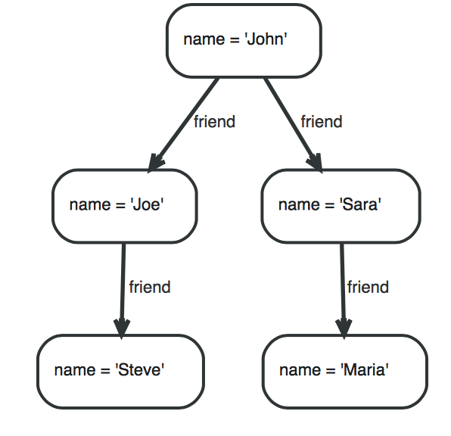
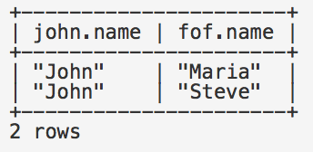
An example
MATCH (john {name: 'John'})-[:friend]->()-[:friend]->(fof) RETURN john.name, fof.name

Slide 5
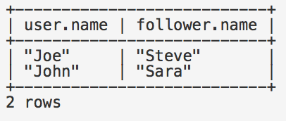
Another example
MATCH (user)-[:friend]->(follower)
WHERE user.name IN ['Joe', 'John', 'Sara', 'Maria', 'Steve’]
AND follower.name =~ 'S.*’
RETURN user.name, follower.name

Slide 6
And for updating the graph
To operate on nodes and relationships
CREATE
DELETE
To (un)assign values to properties and labels on nodes.
SET (can be used with CREATE)
REMOVE
MERGE
Match existing nodes and patterns
Create new nodes and patterns

Slide 7
Setting up keys
CREATE CONSTRAINT ON (node:Label) ASSERT exists(node.property)
All nodes with a given label have a given property
CREATE CONSTRAINT ON (node:Label) ASSERT (node.property1, …​, node.property_{n}) IS NODE KEY
Ensures that nodes with a given label have the specified properties and that the combination of property values is unique

Slide 8
Additional operators
Arithmetic
Boolean
Comparison
String operators
List operators

Slide 9
Many functions!
Predicate
Scalar
List
Mathematical
String
Aggregate

Slide 10
Aggregate functions
avg()- returns average of values for a given property
MATCH (n:Person)
RETURN avg(n.age)
max()
min()
stDev()
sum()

Slide 11
Specifying a pattern in a query
Node patterns
(x): where x is a single node. Note the parentheses!
(x)->(y): relationship between x and y
Label patterns
(x:label)->(y)
(x:label1:label2)->(y)
Properties in patterns
(x {property1: ‘value’, property2: ‘value’})
Relationships in patterns
(x)-[r]->(y), where r is the name of the relationship

Slide 12
Working with external data
LOAD CSV from ‘filename.csv’ AS line
Loads data from filename with each line (row) instantiated as a new node in the graph
LOAD CSV WITH HEADERS from ‘filename.csv’ AS line
Use this when the .csv file has a header with column names
LOAD CSV from ‘filename.csv’ AS line FIELDTERMINATOR ‘x’
x is a field separator, such as , or ;
USING PERIODIC COMMIT LOAD CSV from ‘filename.csv’ AS line
This will cause an automatic commit of the data to the graph after a default of 1000 rows. You can change this by specifying a number after “COMMIT”

Slide 13
https://neo4j.com/docs/developer-manual/current/cypher/keyword-glossary/
See this page for a complete list of clauses

Slide 14
And now on to something a little more complicated
Importing relational data to create
a graph database

Slide 15
Let’s work with a clinical trial in ABIC
Shackford SR, et al.: Hypertonic saline resuscitation of patients with head injury: a prospective, randomized clinical trial. J Trauma 1998 44(1):50-8.
Abstract
BACKGROUND: Experimental and clinical work has suggested that hypertonic saline (HTS) would be better than lactated Ringer's solution (LRS) for the resuscitation of patients with head injuries. No clinical study has examined the effect of HTS infusion on intracranial pressure (ICP) and outcome in patients with head injuries. We hypothesized that HTS infusion would result in a lower ICP and fewer medical interventions to lower ICP compared with LRS.
METHODS/DESIGN: Prospective, randomized clinical trial at two teaching hospitals.
RESULTS: Thirty-four patients were enrolled and were similar in age and Injury Severity Score. HTS patients had a lower admission Glasgow Coma Scale score (HTS: 4.7+/-0.7; LRS: 6.7+/-0.7; p = 0.057), a higher initial ICP (HTS: 16+/-2; LRS: 11+/-2; p = 0.06), and a higher initial mean maximum ICP (HTS: 31+/-3; LRS: 18+/-2; p < 0.01). Treatment effectively lowered ICP in both groups, and there was no significant difference between the groups in ICP at any time after entry. HTS patients required significantly more interventions (HTS: 31+/-4; LRS: 11+/-3; p < 0.01). During the study, the change in maximum ICP was positive in the LRS group but negative in the HTS group (LRS: +2+/-3; HTS: -9+/-4; p < 0.05).
CONCLUSION: As a group, HTS patients had more severe head injuries. HTS and LRS used
with other therapies effectively controlled the ICP. The widely held conviction that sodium administration will lead to a sustained increase in ICP is not supported by this work.

Slide 16
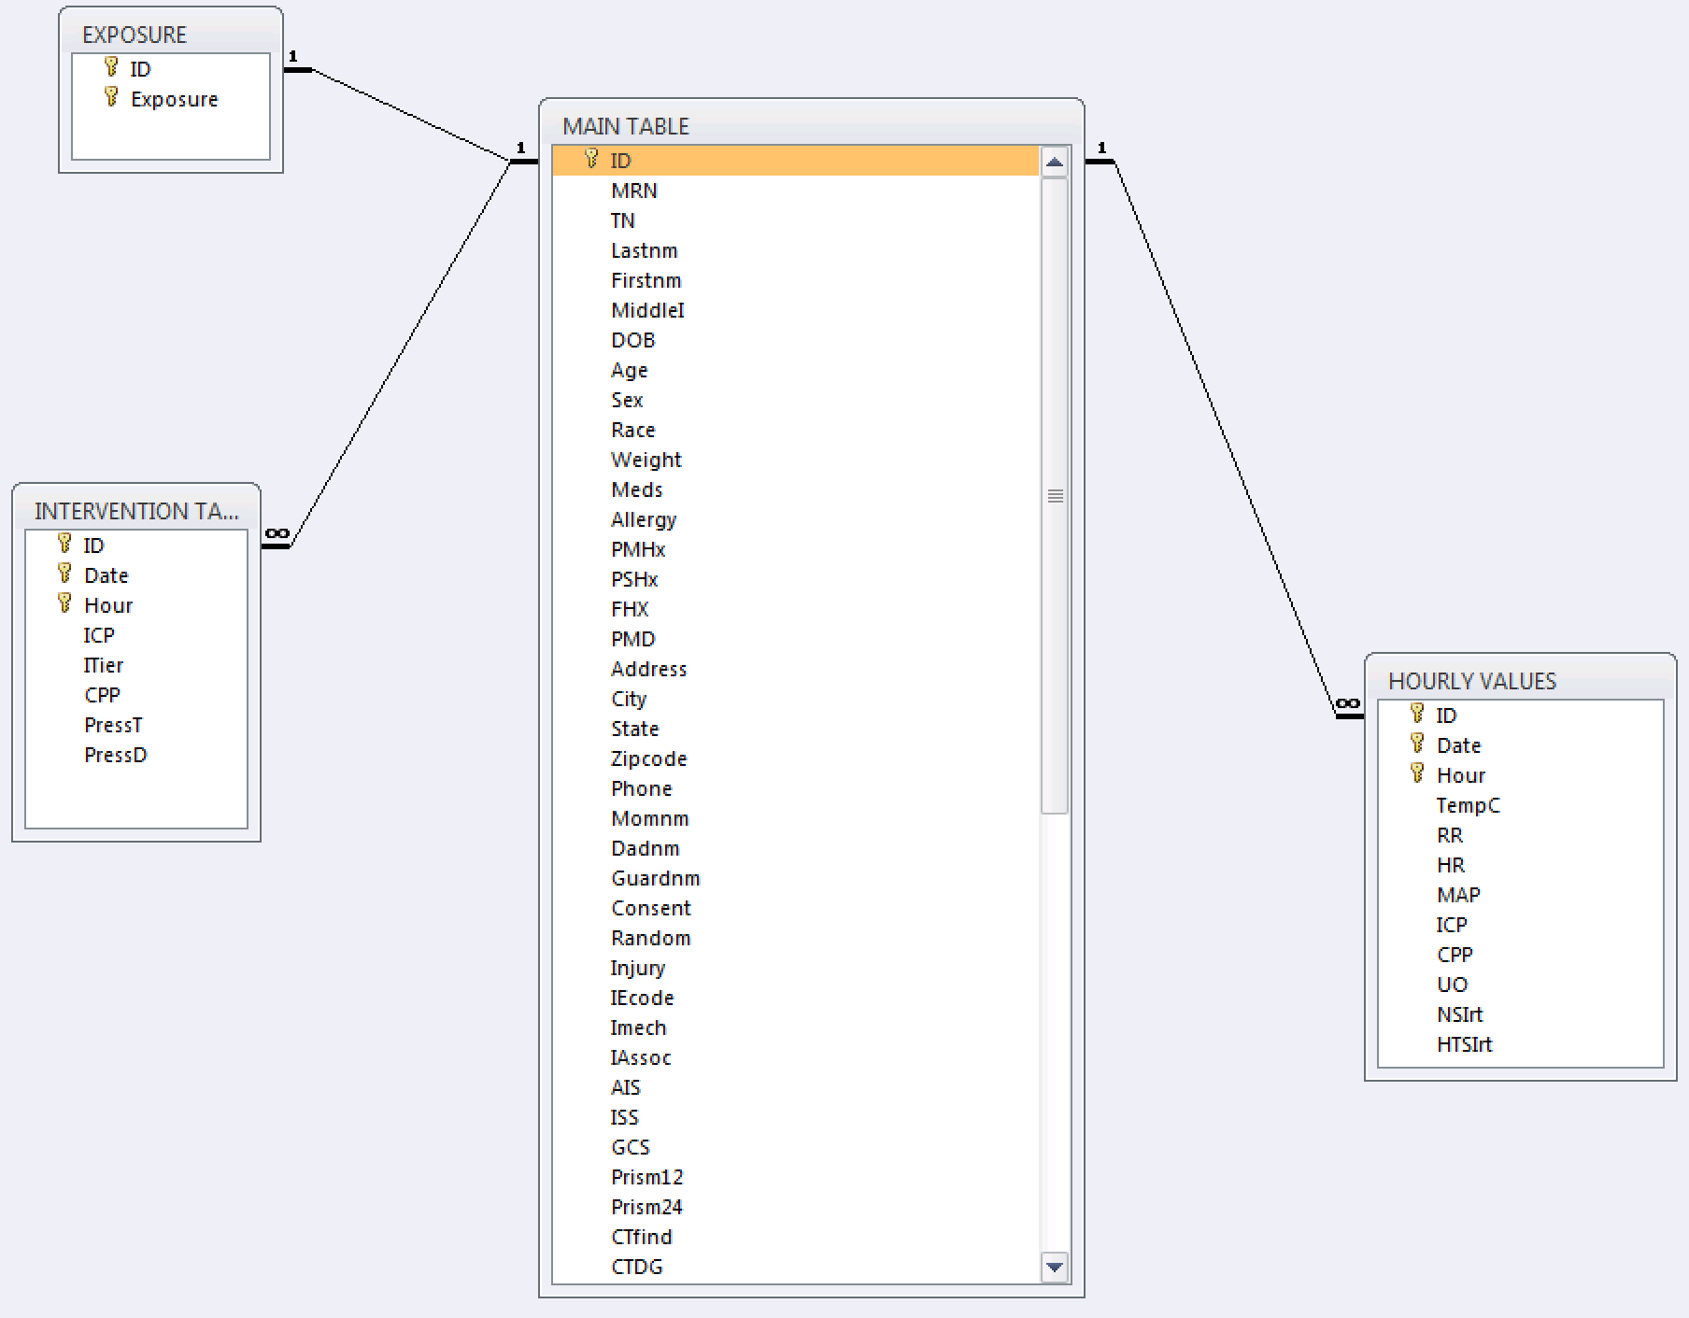
Here is the E-R model

Slide 17
But we are going to write queries to import these data
First, let’s walk through a
non-medical example:
The Northwind Database
https://neo4j.com/developer/guide-importing-data-and-etl/

Slide 18
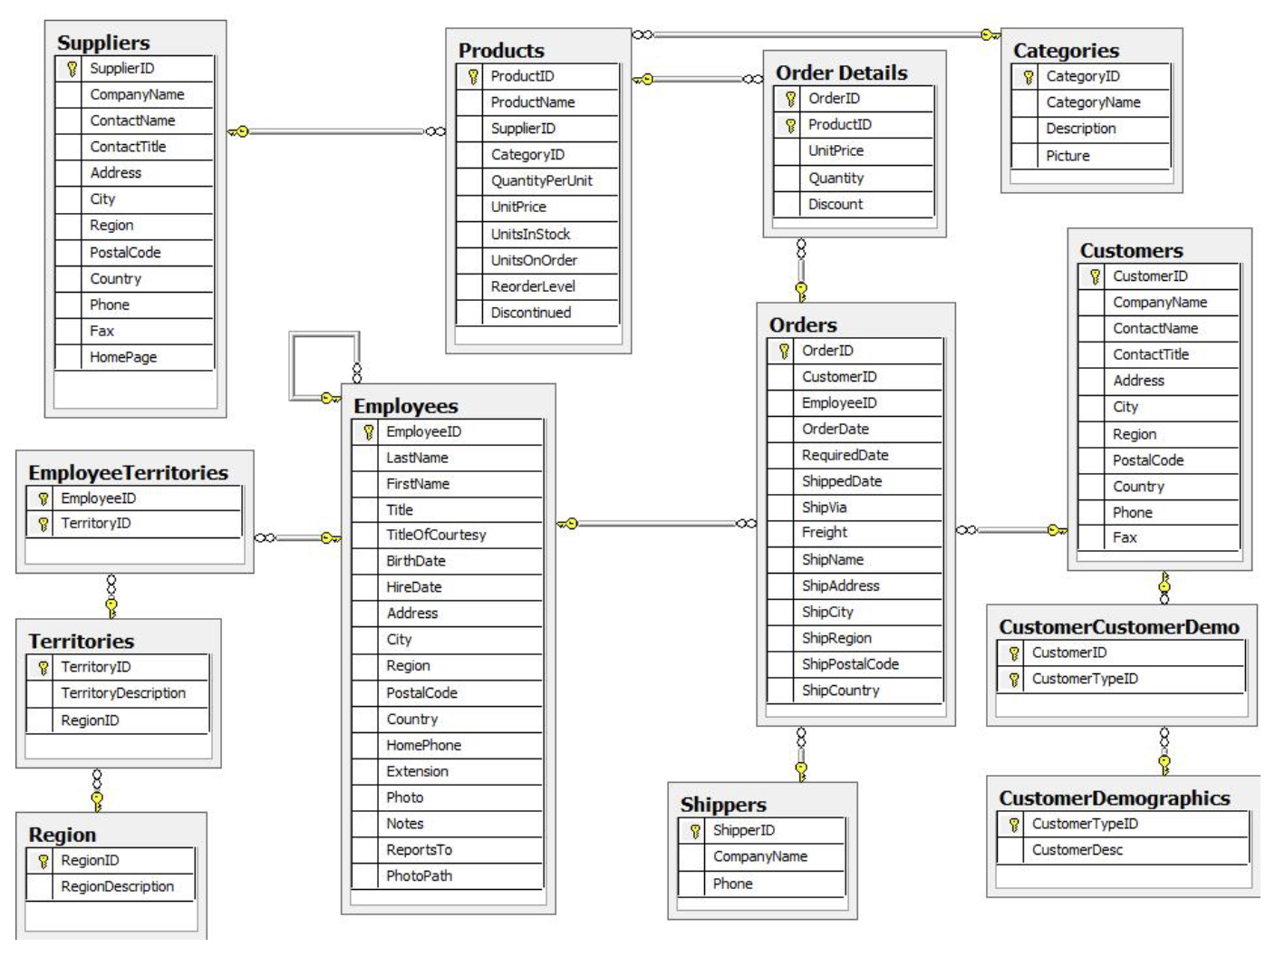

Slide 19
Steps to create graph model
Describe the domain
Identify the nodes
Identify the labels
Identify the properties
Construct the relationships

Slide 20
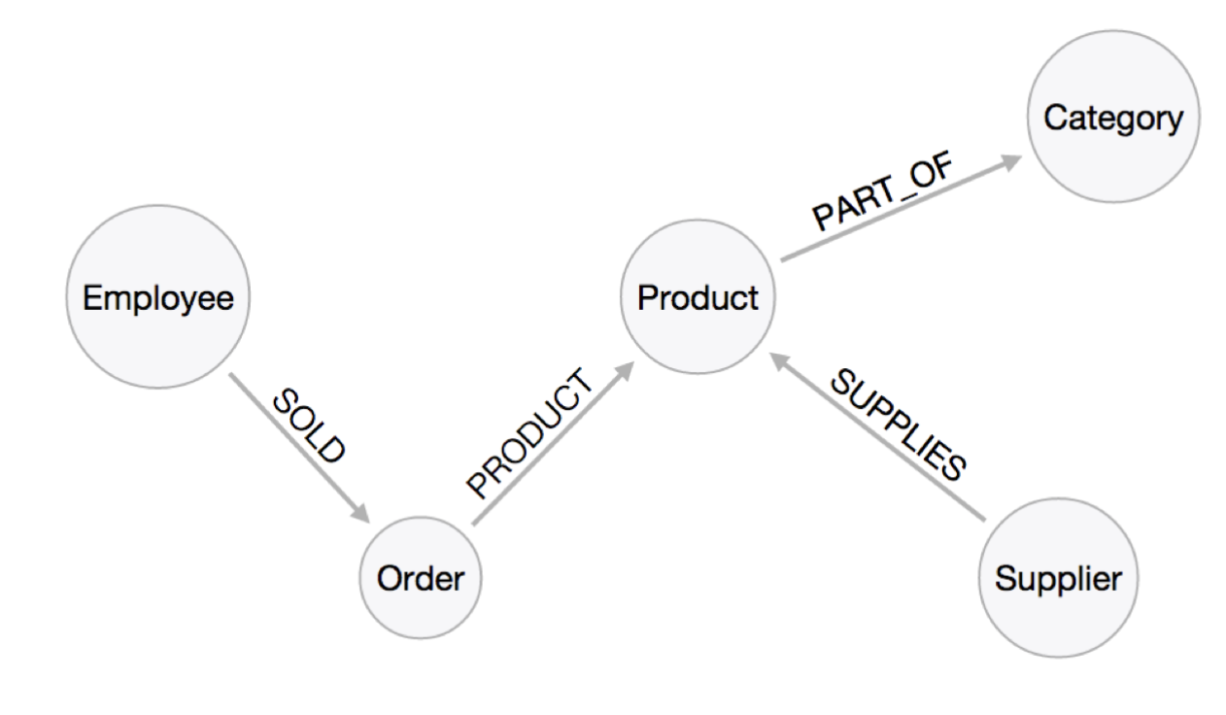
And the graph model

Slide 21
Step 0: Download the data from Canvas (all csv format)
Categories
Customers
Employees
Orders
Products
Suppliers
And place in an easily accessible folder

Slide 22
Step 1: Import each .csv file
// Create customers
USING PERIODIC COMMIT
LOAD CSV WITH HEADERS FROM "file:customers.csv" AS row
CREATE (:Customer {companyName: row.CompanyName, customerID: row.CustomerID, fax: row.Fax, phone: row.Phone});
Note: “file:customers.csv” will need to reflect the path, such as
“/Users/Courses/BMIN 502-EPID 635/In-class exercises /Northwind”
Repeat for
Categories
Employees
Products
Suppliers

Slide 23
Step 1a: Orders, as the canonical file, needs special treatment
USING PERIODIC COMMIT LOAD CSV WITH HEADERS FROM "file:orders.csv" AS row
MERGE (order:Order {orderID: row.OrderID}) ON CREATE SET order.shipName = row.ShipName;

Slide 24
Step 2: Create indexes on each node
CREATE INDEX ON :Product(productID);
CREATE INDEX ON :Product(productName);
CREATE INDEX ON :Category(categoryID);
CREATE INDEX ON :Employee(employeeID);
CREATE INDEX ON :Supplier(supplierID);
CREATE INDEX ON :Customer(customerID);
CREATE INDEX ON :Customer(customerName);
And for Orders:
CREATE CONSTRAINT ON (o:Order) ASSERT o.orderID IS UNIQUE;
After all of the nodes are indexed, type schema wait
to delay populating the nodes until the indexes are created.

Slide 25
Step 3: Create the relationships between Orders, Products, Employees, and Customers
USING PERIODIC COMMIT
LOAD CSV WITH HEADERS FROM "file:orders.csv" AS row
MATCH (order:Order {orderID: row.OrderID})
MATCH (product:Product {productID: row.ProductID})
MERGE (order)-[pu:PRODUCT]->(product)
ON CREATE SET pu.unitPrice = toFloat(row.UnitPrice), pu.quantity = toFloat(row.Quantity);
Repeat for each of the child tables-
Employees and Customers

Slide 26
Step 4: Create the relationships between Products, Suppliers, and Categories
USING PERIODIC COMMIT
LOAD CSV WITH HEADERS FROM "file:products.csv" AS row
MATCH (product:Product {productID: row.ProductID})
MATCH (supplier:Supplier {supplierID: row.SupplierID})
MERGE (supplier)-[:SUPPLIES]->(product);
USING PERIODIC COMMIT
LOAD CSV WITH HEADERS FROM "file:products.csv" AS row
MATCH (product:Product {productID: row.ProductID})
MATCH (category:Category {categoryID: row.CategoryID})
MERGE (product)-[:PART_OF]->(category);

Slide 27
Step 5: Create the REPORTS_TO relationship between Employees
USING PERIODIC COMMIT
LOAD CSV WITH HEADERS FROM "file:employees.csv" AS row MATCH (employee:Employee {employeeID: row.EmployeeID}) MATCH (manager:Employee {employeeID: row.ReportsTo}) MERGE (employee)-[:REPORTS_TO]->(manager);

Slide 28
Now, let’s do some queries!
Which Employee had the Highest Cross-Selling Count of ‘Chocolade’ and Which Product?
MATCH (choc:Product {productName:'Chocolade'})<-[:PRODUCT]-(:Order)<-[:SOLD]-(employee), (employee)-[:SOLD]->(o2)-[:PRODUCT]->(other:Product)
RETURN employee.employeeID, other.productName, count(distinct o2) as count
ORDER BY count
DESC LIMIT 5;

Slide 29
And another
How are Employees Organized?
Who Reports to Whom?
MATCH path = (e:Employee)<-[:REPORTS_TO]-(sub)
RETURN e.employeeID AS manager, sub.employeeID AS employee;

Slide 30
Back to our clinical trial
Which is also Assignment 12!

Slide 31
Let’s work with a clinical trial in ABIC
Shackford SR, et al.: Hypertonic saline resuscitation of patients with head injury: a prospective, randomized clinical trial. J Trauma 1998 44(1):50-8.
Abstract
BACKGROUND: Experimental and clinical work has suggested that hypertonic saline (HTS) would be better than lactated Ringer's solution (LRS) for the resuscitation of patients with head injuries. No clinical study has examined the effect of HTS infusion on intracranial pressure (ICP) and outcome in patients with head injuries. We hypothesized that HTS infusion would result in a lower ICP and fewer medical interventions to lower ICP compared with LRS.
METHODS/DESIGN: Prospective, randomized clinical trial at two teaching hospitals.
RESULTS: Thirty-four patients were enrolled and were similar in age and Injury Severity Score. HTS patients had a lower admission Glasgow Coma Scale score (HTS: 4.7+/-0.7; LRS: 6.7+/-0.7; p = 0.057), a higher initial ICP (HTS: 16+/-2; LRS: 11+/-2; p = 0.06), and a higher initial mean maximum ICP (HTS: 31+/-3; LRS: 18+/-2; p < 0.01). Treatment effectively lowered ICP in both groups, and there was no significant difference between the groups in ICP at any time after entry. HTS patients required significantly more interventions (HTS: 31+/-4; LRS: 11+/-3; p < 0.01). During the study, the change in maximum ICP was positive in the LRS group but negative in the HTS group (LRS: +2+/-3; HTS: -9+/-4; p < 0.05).
CONCLUSION: As a group, HTS patients had more severe head injuries. HTS and LRS used
with other therapies effectively controlled the ICP. The widely held conviction that sodium administration will lead to a sustained increase in ICP is not supported by this work.

Slide 32
Here is the E-R model

Slide 33
Let’s review the data dictionary…

Slide 34
And take a look at the data
MAIN TABLE.CSV
EXPOSURE.CSV
HOURLY VALUES.CSV
INTERVENTION TABLE.CSV

Slide 35
Here is the E-R model, revisited
Let’s create a graph model!

Slide 36
Steps to create graph model
Describe the domain
Identify the nodes
Identify the labels
Identify the properties
Construct the relationships

Slide 37
And on to Assignment 12 Hypertonic Saline Study
Download from Canvas
The manuscript (Hypertonic Saline Resuscitation of Patients with Head Injury)
Data dictionary
The data
Exposure
Hourly values
Intervention
Main table
Write the queries to import the data into a graph
Write three queries of interest on the data
Examples:
What is the minimum GCS in the trial population?
What is the average mean arterial pressure for females between the ages of 18 and 45 who were treated with hypertonic saline?
…

